Slide 1
Dynamic Programming:
LCS, 0-1 Knapsack

Slide 2
Longest Common Subsequence
Given two sequences
  X = ⟨ x₁, x₂, …, x_{m} ⟩
  Y = ⟨ y₁, y₂, …, y_{n} ⟩
A subsequence of a given sequence is just the given sequence with zero or more elements left out.
A common subsequence Z = ⟨ z₁, z₂, …, z_{k} ⟩ of X and Y
  Z is a subsequence of both X and Y
Example:
  X = A B C B D A B
  Y = B D C A B A
Goal: Find the Longest Common Subsequence (LCS)

Slide 3
An Impractical LCS Algorithm
Brute-force algorithm: For every subsequence of x, check if it is a subsequence of y
  How many subsequences of x are there?
  What will be the running time of the brute-force algorithm?
2^{m} subsequences of x to check against n elements of y
  Running time: O(n 2^{m})

Slide 4
Optimal Substructure Property of LCS
The LCS problem has an optimal substructure property
    solutions of subproblems are parts of the final solution
    Subproblems: LCS of pairs of prefixes of X and Y
  An LCS of two sequences contains within it an LCS of prefixes of the two sequences.
Given a sequence X = ⟨ x₁, x₂, …, x_{m} ⟩, we define the ith prefix of X as X_{i} = ⟨ x₁, x₂, …, x_{i} ⟩
Example:
  X = ABCBDABBDCAB
  X₅ = ABCBD
  X₇ = ABCBDAB

Slide 5
Optimal Substructure Property of LCS
Theorem:
Let X = ⟨ x₁, x₂, …, x_{m} ⟩ and Y = ⟨ y₁, y₂, …, y_{n} ⟩ be any sequences, and let Z = ⟨ z₁, z₂, …, z_{k} ⟩ be any LCS of X and Y.
  If x_{m} = y_{n}, then z_{k} = x_{m} = y_{n} and Z_{k – 1} is an LCS of X_{m – 1} and Y_{n – 1}.
  If x_{m} ≠ y_{n}, then z_{k} ≠ x_{m} implies that Z is an LCS of X_{m – 1} and Y.
  If x_{m} ≠ y_{n}, then z_{k} ≠ y_{n} implies that Z is an LCS of X and Y_{n – 1}.
Proof ?
The Theorem tells us that an LCS of two sequences contains within it an LCS of prefixes of the two sequences.
Thus the LCS problem has an optimal substructure property.

Slide 6
Overlapping Subproblem Property of LCS
Theorem:
Let X = ⟨ x₁, x₂, …, x_{m} ⟩ and Y = ⟨ y₁, y₂, …, y_{n} ⟩ be any sequences, and let Z = ⟨ z₁, z₂, …, z_{k} ⟩ be any LCS of X and Y.
  If x_{m} = y_{n}, then z_{k} = x_{m} = y_{n} and Z_{k – 1} is an LCS of X_{m – 1} and Y_{n – 1}.
  If x_{m} ≠ y_{n}, then z_{k} ≠ x_{m} implies that Z is an LCS of X_{m – 1} and Y.
  If x_{m} ≠ y_{n}, then z_{k} ≠ y_{n} implies that Z is an LCS of X and Y_{n – 1}.
The Theorem tells us that
  To find an LCS of X and Y, we may need to find the LCSs of X and Y_{n – 1} and of X_{m – 1} and Y. But each of these subproblems has the subsubproblem of finding an LCS of X_{m – 1} and Y_{n – 1}.
  Thus the LCS problem has the overlapping subproblem property.
The number of distinct subproblems: O(mn).

Slide 7
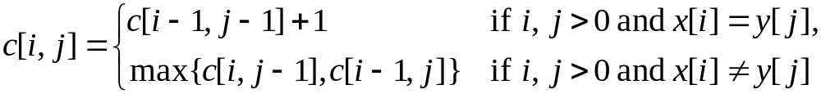
Develop a Recursive Solution
Define c[i, j] to be the length of an LCS of the sequences X_{i} and Y_{j} .
  Goal: Find c[m, n]
  Basis: c[i, j] = 0 if either i = 0 or j = 0
  Recursion: How to define c[i, j] recursively ?
Finding an LCS of X = ⟨ x₁, x₂, …, x_{m} ⟩ and Y = ⟨ y₁, y₂, …, y_{n} ⟩
    If x_{m} = y_{n}, then we must find an LCS of X_{m – 1} and Y_{n – 1}.
    Appending x_{m} = y_{n} to this LCS yields an LCS of X and Y.
  If x_{m} ≠ y_{n}, then we must solve two subproblems:
    Finding an LCS of X_{m – 1} and Y
    Finding an LCS of X and Y_{n – 1}
    Whichever of these two LCSs is longer is an LCS of X and Y.
The recursive formula is

Slide 8
Develop a Recursive Solution
Case 1: x_{i} = y_{j}
  Recursively find LCS of X_{i – 1} and Y_{j – 1} and append x_{i}
  So c[i, j] = c[i – 1, j – 1] + 1 if i, j > 0, and x_{i} = y_{j}
X_{i-1}
x_{i}
equal
Y_{j-1}
y_{j}

Slide 9
Develop a Recursive Solution
Case 2: x_{i} ≠ y_{j}
  Recursively find LCS of X_{i – 1} and Y_{j}
  Recursively find LCS of X_{i} and Y_{j – 1}
  Take the longer one
  So c[i, j] = max{c[i, j – 1], c[i – 1, j]} if i, j > 0, and x_{i} ≠ y_{j}
X_{i-1}
x_{i}
not equal
Y_{j-1}
y_{j}

Slide 10
Dependencies among Subproblems
0
1
j-1
j
n
0
c[i, j] depends on
c[i-1, j-1],
c[i-1, j], and
c[i, j-1]
1
i-1
i
m
Goal
An order for solving the subproblems (i.e., filling in the array) that respects the dependencies is row major order:
  do the rows from top to bottom
  inside each row, go from left to right

Slide 11
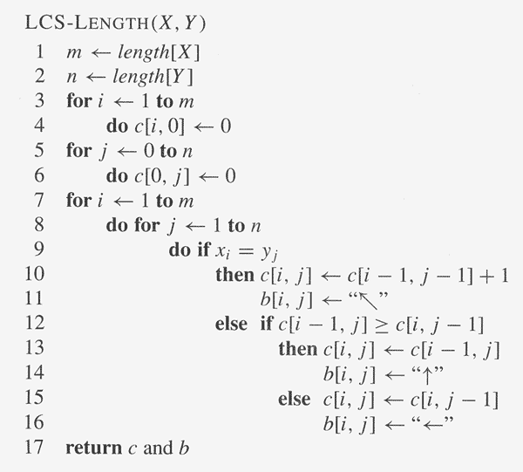
Develop a Recursive Solution
The algorithm calculates the values of each entry of the array c[m, n].
Each c[i, j] is calculated in constant time, and there are m·n elements in the array.
So the running time is O(m·n).

Slide 12
LCS Example
We’ll see how LCS algorithm works on the following example:
X = ABCG
Y = BDCAG
LCS(X, Y) = BCG
X = A B C G
Y = B D C A G

Slide 13
LCS Example
ABCG
BDCAG
j 0 1 2 3 4 5
i
y_{j}
B
D
C
A
G
0
x_{i}
A
1
2
B
3
C
4
G
X = ABCG; m = |X| = 4
Y = BDCAG; n = |Y| = 5
Allocate array: c[5, 4]

Slide 14
LCS Example
ABCG
BDCAG
j 0 1 2 3 4 5
i
y_{j}
B
D
C
A
G
0
x_{i}
0
0
0
0
0
0
A
1
0
2
B
0
3
C
0
4
G
0
for i = 0 to m c[i, 0] = 0
for j = 1 to n c[0, j] = 0

Slide 15
LCS Example
ABCG
BDCAG
j 0 1 2 3 4 5
i
y_{j}
B
D
C
A
G
0
x_{i}
0
0
0
0
0
0
A
1
0
0
2
B
0
3
C
0
4
G
0
if ( x_{i} == y_{j} )
c[i, j] = c[i-1, j-1] + 1
else c[i, j] = max( c[i-1, j], c[i, j-1] )

Slide 16
LCS Example
ABCG
BDCAG
j 0 1 2 3 4 5
i
y_{j}
B
D
C
A
G
0
x_{i}
0
0
0
0
0
0
A
1
0
0
0
0
2
B
0
3
C
0
4
G
0
if ( x_{i} == y_{j} )
c[i, j] = c[i-1, j-1] + 1
else c[i, j] = max( c[i-1, j], c[i, j-1] )

Slide 17
LCS Example
ABCG
BDCAG
j 0 1 2 3 4 5
i
y_{j}
B
D
C
A
G
0
x_{i}
0
0
0
0
0
0
A
1
0
0
0
0
1
2
B
0
3
C
0
4
G
0
if ( x_{i} == y_{j} )
c[i, j] = c[i-1, j-1] + 1
else c[i, j] = max( c[i-1, j], c[i, j-1] )

Slide 18
LCS Example
ABCG
BDCAG
j 0 1 2 3 4 5
i
y_{j}
B
D
C
A
G
0
x_{i}
0
0
0
0
0
0
A
1
0
0
0
0
1
1
2
B
0
3
C
0
4
G
0
if ( x_{i} == y_{j} )
c[i, j] = c[i-1, j-1] + 1
else c[i, j] = max( c[i-1, j], c[i, j-1] )

Slide 19
LCS Example
ABCG
BDCAG
j 0 1 2 3 4 5
i
y_{j}
B
D
C
A
G
0
x_{i}
0
0
0
0
0
0
A
1
0
0
0
0
1
1
2
B
0
1
3
C
0
4
G
0
if ( x_{i} == y_{j} )
c[i, j] = c[i-1, j-1] + 1
else c[i, j] = max( c[i-1, j], c[i, j-1] )

Slide 20
LCS Example
ABCG
BDCAG
j 0 1 2 3 4 5
i
y_{j}
B
D
C
A
G
0
x_{i}
0
0
0
0
0
0
A
1
0
0
0
0
1
1
2
B
0
1
1
1
1
3
C
0
4
G
0
if ( x_{i} == y_{j} )
c[i, j] = c[i-1, j-1] + 1
else c[i, j] = max( c[i-1, j], c[i, j-1] )

Slide 21
LCS Example
ABCG
BDCAG
j 0 1 2 3 4 5
i
y_{j}
B
D
C
A
G
0
x_{i}
0
0
0
0
0
0
A
1
0
0
0
0
1
1
2
B
0
1
1
1
1
1
3
C
0
4
G
0
if ( x_{i} == y_{j} )
c[i, j] = c[i-1, j-1] + 1
else c[i, j] = max( c[i-1, j], c[i, j-1] )

Slide 22
LCS Example
ABCG
BDCAG
j 0 1 2 3 4 5
i
y_{j}
B
D
C
A
G
0
x_{i}
0
0
0
0
0
0
A
1
0
0
0
0
1
1
2
B
0
1
1
1
1
2
3
C
0
1
1
4
G
0
if ( x_{i} == y_{j} )
c[i, j] = c[i-1, j-1] + 1
else c[i, j] = max( c[i-1, j], c[i, j-1] )

Slide 23
LCS Example
ABCG
BDCAG
j 0 1 2 3 4 5
i
y_{j}
B
D
C
A
G
0
x_{i}
0
0
0
0
0
0
A
1
0
0
0
0
1
1
2
B
0
1
1
1
1
2
3
C
0
1
1
2
4
G
0
if ( x_{i} == y_{j} )
c[i, j] = c[i-1, j-1] + 1
else c[i, j] = max( c[i-1, j], c[i, j-1] )

Slide 24
LCS Example
ABCG
BDCAG
j 0 1 2 3 4 5
i
y_{j}
B
D
C
A
G
0
x_{i}
0
0
0
0
0
0
A
1
0
0
0
0
1
1
2
B
0
1
1
1
1
1
3
C
0
1
1
2
2
2
4
G
0
if ( x_{i} == y_{j} )
c[i, j] = c[i-1, j-1] + 1
else c[i, j] = max( c[i-1, j], c[i, j-1] )

Slide 25
LCS Example
ABCG
BDCAG
j 0 1 2 3 4 5
i
y_{j}
B
D
C
A
G
0
x_{i}
0
0
0
0
0
0
A
1
0
0
0
0
1
1
2
B
0
1
1
1
1
1
3
C
0
1
1
2
2
2
4
G
0
1
if ( x_{i} == y_{j} )
c[i, j] = c[i-1, j-1] + 1
else c[i, j] = max( c[i-1, j], c[i, j-1] )

Slide 26
LCS Example
ABCG
BDCAG
j 0 1 2 3 4 5
i
y_{j}
B
D
C
A
G
0
x_{i}
0
0
0
0
0
0
A
1
0
0
0
0
1
1
2
B
0
1
1
1
1
1
3
C
0
1
1
2
2
2
4
G
0
1
1
2
2
if ( x_{i} == y_{j} )
c[i, j] = c[i-1, j-1] + 1
else c[i, j] = max( c[i-1, j], c[i, j-1] )

Slide 27
LCS Example
ABCG
BDCAG
j 0 1 2 3 4 5
i
y_{j}
B
D
C
A
G
0
x_{i}
0
0
0
0
0
0
A
1
0
0
0
0
1
1
2
B
0
1
1
1
1
1
3
C
0
1
1
2
2
2
4
G
3
0
1
1
2
2
if ( x_{i} == y_{j} )
c[i, j] = c[i-1, j-1] + 1
else c[i, j] = max( c[i-1, j], c[i, j-1] )

Slide 28
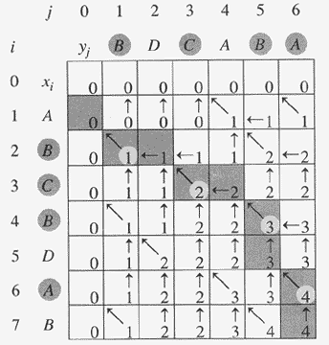
Another LCS Example

Slide 29
How to Find Actual LCS
So far, we have just found the length of LCS, but not LCS itself.
We can modify this algorithm to make it output an LCS of X and Y.
Each c[i, j] depends on c[i-1, j-1], or c[i-1, j] and c[i, j-1].
For each c[i, j] we can say how it was acquired.
2
2
For example, here
c[i, j] = c[i-1, j-1] +1 = 2+1=3
2
3

Slide 30

How to Find Actual LCS
Remember that
So we can start from c[m, n] and go backwards
Whenever c[i, j] = c[i-1, j-1]+1, remember x[i], because x[i] is a part of LCS
When i=0 or j=0 (i.e. we reached the beginning), output remembered letters in reverse order

Slide 31
Finding LCS: Example
j 0 1 2 3 4 5
i
y_{j}
B
D
C
A
G
0
x_{i}
0
0
0
0
0
0
A
1
0
0
0
0
1
1
2
B
0
1
1
1
1
2
3
C
0
1
1
2
2
2
4
G
3
0
1
1
2
2

Slide 32
Finding LCS: Example
j 0 1 2 3 4 5
i
y_{j}
B
D
C
A
G
0
x_{i}
0
0
0
0
0
0
A
1
0
0
0
0
1
1
2
B
0
1
1
1
1
2
3
C
0
1
1
2
2
2
4
G
3
0
1
1
2
2
LCS (reversed order):
G
C
B
LCS (straight order):
B C G

Slide 33
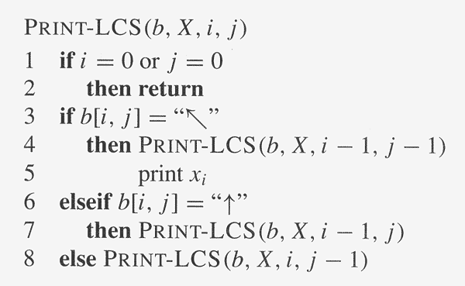
Finding LCS: Algorithm
Trace backwards from b[m, n]

Slide 35
The Knapsack Problem
The famous Knapsack Problem:
  A thief breaks into a museum. Fabulous paintings, sculptures, and jewels are everywhere. The thief has a good eye for the value of these objects, and knows that each will fetch hundreds or thousands of dollars on the clandestine art collector’s market. But, the thief has only brought a single knapsack to the scene of the robbery, and can take away only what he can carry. What items should the thief take to maximize the haul?
Which items should I take?

Slide 36
The Knapsack Problem
There are two versions of the problem:
  (1) “0-1 knapsack problem”
  Items are indivisible: you either take an item or not. Solved with dynamic programming.
  (2) “Fractional knapsack problem”
  Items are divisible: you can take any fraction of an item. Solved with a greedy algorithm.

Slide 37
The Knapsack Problem
More formally, the 0-1 knapsack problem:
  The thief must choose among n items, where the ith item worth v_{i} dollars and weighs w_{i} pounds
  Carrying at most W pounds, maximize value
    Note: assume v_{i}, w_{i}, and W are all integers
    “0-1” because each item must be taken or left in entirety
A variation, the fractional knapsack problem:
  Thief can take fractions of items
Think of items in 0-1 problem as gold ingots, in fractional problem as buckets of gold dust.

Slide 38
Optimal Substructure Property
Both problems exhibit the optimal substructure property.
To show this for both the problems, consider the most valuable load weighing at most W pounds
  Q: If we remove item j from the load, what do we know about the remaining load?
  A: The remaining load must be the most valuable load weighing at most W - w_{j} that the thief could take from the n-1 original items excluding item j.

Slide 39
Fractional Knapsack Problem
Knapsack capacity: W
There are n items: the i-th item has value v_{i} and weight w_{i}
Goal:
  find x_{i} such that for all 0 ≤ x_{i} ≤ 1, i = 1, 2, .., n
  ∑ w_{i}x_{i} ≤ W and
  ∑ x_{i}v_{i} is maximum

Slide 40
Fractional Knapsack - Example
50
20
---
30
50
$80
+
Item 3
Item 2
30
20
$100
+
Item 1
20
10
10
$60
$60
$100
$120
$240
$6/pound
$5/pound
$4/pound

Slide 41
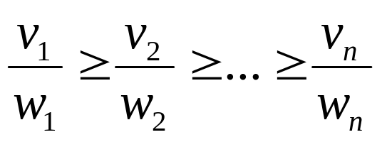
Fractional Knapsack Problem
Greedy strategy:
Pick the item with the maximum value per pound v_{i}/w_{i}
If the supply of that element is exhausted and the thief can carry more: take as much as possible from the item with the next greatest value per pound
It is good to order items based on their value per pound

Slide 42
Fractional Knapsack Problem
Alg.: Fractional-Knapsack (W, v[n], w[n])
while w > 0 and as long as there are items remaining
pick item with maximum v_{i}/w_{i}
x_{i} ← min (1, w/w_{i})
remove item i from list
w ← w – x_{i}w_{i}
w – the amount of space remaining in the knapsack (initially w = W)
Running time: Θ(n) if items already ordered; else Θ(nlogn)

Slide 43
Greedy Algorithms
Similar to dynamic programming, but simpler approach
  Also used for optimization problems
Idea: When we have a choice to make, make the one that looks best right now
  Make a locally optimal choice in hope of getting a globally optimal solution
Greedy algorithms don’t always yield an optimal solution
Makes the choice that looks best at the moment in order to get optimal solution.

Slide 44
0-1 Knapsack problem
Thief has a knapsack with maximum capacity W, and a set S consisting of n items
Each item i has some weight w_{i} and benefit value v_{i} (all w_{i} , v_{i} and W are integer values)
Problem: How to pack the knapsack to achieve maximum total value of packed items?
Goal:
  find x_{i} such that for all x_{i} ∈ {0, 1}, i = 1, 2, .., n
  ∑ w_{i}x_{i} ≤ W and
  ∑ x_{i}v_{i} is maximum

Slide 45
0-1 Knapsack - Greedy Strategy
50
50
50
30
Item 3
$120
+
Item 2
30
20
$100
+
Item 1
20
20
$100
10
10
$60
$60
$100
$120
W
$160
$220
$6/pound
$5/pound
$4/pound

Slide 46
0-1 Knapsack: Brute-Force Approach
Since there are n items, there are 2^{n} possible combinations of items.
We go through all combinations and find the one with the most total value and with total weight less or equal to W.
Running time will be O(2^{n}).

Slide 47
0-1 Knapsack - Dynamic Programming
P(i, w) – the maximum profit that can be obtained from items 1 to i, if the knapsack has size w
Case 1: thief takes item i
P(i, w) =
Case 2: thief does not take item i
P(i, w) =
v_{i} + P(i - 1, w-w_{i})
P(i - 1, w)

Slide 48
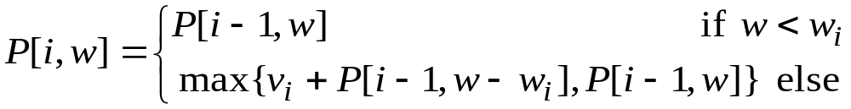
Recursive Formula
The best subset that has the total weight w, either contains item i or not.
First case: w <w_{i}. Item i can’t be part of the solution, since if it was, the total weight would be > w, which is unacceptable.
Second case: w >= w_{i}. Then the item i can be in the solution, and we choose the case with greater value.

Slide 49
Dependencies among Subproblems
Item i was taken
Item i was not taken
P(i, w) = max {v_{i} + P(i - 1, w-w_{i}), P(i - 1, w) }
0:
1
w - w_{i}
w
W
0
0 | 0 | 0 | 0 | 0 | 0 | 0 | 0 | 0 | 0 | 0
0
0
0
0
0
0
first
second
i-1
i
n

Slide 50
Overlapping Subproblems
P(i, w) = max {v_{i} + P(i - 1, w-w_{i}), P(i - 1, w) }
0:
1
w
W
0
0 | 0 | 0 | 0 | 0 | 0 | 0 | 0 | 0 | 0 | 0
0
0
0
0
0
0
i-1
i
n
E.g.: all the subproblems shown in grey may depend on P(i-1, w)

Slide 51
W = 5
Item | Weight | Value
1 | 2 | 12
2 | 1 | 10
3 | 3 | 20
4 | 2 | 15
Example:
P(i, w) = max {v_{i} + P(i - 1, w-w_{i}), P(i - 1, w) }
0
1
2
3
4
5
0
0 | 0 | 0 | 0 | 0 | 0
0
0
0
0
P(1, 1) =
P(0, 1) = 0
1
0
12
12
12
12
P(1, 2) =
max{12+0, 0} = 12
2
10
12
22
22
22
P(1, 3) =
max{12+0, 0} = 12
3
10
12
22
30
32
P(1, 4) =
max{12+0, 0} = 12
4
10
15
25
30
37
P(1, 5) =
max{12+0, 0} = 12
P(2, 1)=
max{10+0, 0} = 10
P(3, 1)=
P(2,1) = 10
P(4, 1)=
P(3,1) = 10
P(2, 2)=
max{10+0, 12} = 12
P(3, 2)=
P(2,2) = 12
P(4, 2)=
max{15+0, 12} = 15
P(2, 3)=
max{10+12, 12} = 22
P(3, 3)=
max{20+0, 22}=22
P(4, 3)=
max{15+10, 22}=25
P(2, 4)=
max{10+12, 12} = 22
P(3, 4)=
max{20+10,22}=30
P(4, 4)=
max{15+12, 30}=30
P(2, 5)=
max{10+12, 12} = 22
P(4, 5)=
max{20+12,22}=32
P(4, 5)=
max{15+22, 32}=37

Slide 52
Reconstructing the Optimal Solution
0
1
2
3
4
5
0
0 | 0 | 0 | 0 | 0 | 0
0
0
0
0
Item 4
1
0
12
12
12
12
Item 2
2
10
12
22
22
22
3
10
12
22
30
32
Item 1
4
10
15
25
30
37
Start at P(n, W)
When you go left-up ⇒ item i has been taken
When you go straight up ⇒ item i has not been taken

Slide 53
0-1 Knapsack Algorithm
for w = 0 to W
P[0, w] = 0
for i = 0 to n
P[i, 0] = 0
for w = 0 to W
if w_{i} <= w // item i can be part of the solution
if (v_{i} + P[i-1, w-w_{i}] > P[i-1, w])
P[i, w] = v_{i} + P[i-1, w- w_{i}]
else
P[i, w] = P[i-1, w]
else P[i, w] = P[i-1, w] // w_{i} > w
Running time: O(n*W)

